Slide 1
Welcome March 20, 2023

Slide 2
Supervised By: Ahmed Imtiaz lecturer Department of Computer Science and Engineering Rangamati Science and Technology University
Presented By: U Mong Sing Marma Biplob Reg: 2016-13-40 Department of Computer Science and Engineering Rangamati Science and Technology University
A Study of Predicting Student Dropout Using Machine Learning in Rural Areas of Bandarban Hill Tracts, Bangladesh
2

Slide 3
Outline
Problem statement
Motivation of research
Proposed method
Dataset collection
Dataset description
Model comparison
Confusion matrix
Data exploration
Query
User interface
Limitation
Future work
3

Slide 4
Problem Statement
Using machine learning to predict students are at risk of dropping out from mainstream education due to family-related factors and socioeconomic status in the rural area of Bandarban Hill Tracts, Bangladesh.
4

Slide 5
Motivation of research
Rural areas of Bandarban Hill Tracts educational diversity
According to literacy assessment survey (BBS-2011) , CHT average literacy rate is 43.9%, which is lower than 51.8% of national average.
The dropout rate is exceptionally high at roughly 59%, compare to the national average of 19.2% according to Educational Structure of Bangladesh (BANBEIS-2016).
UNDP-Bangladesh, children in Bangladesh's indigenous minority community have literacy and completion rates that are much lower than the country's averages
Rashid, S. (2018). Asia-Pacific ICH NGO Conference
5

Slide 6
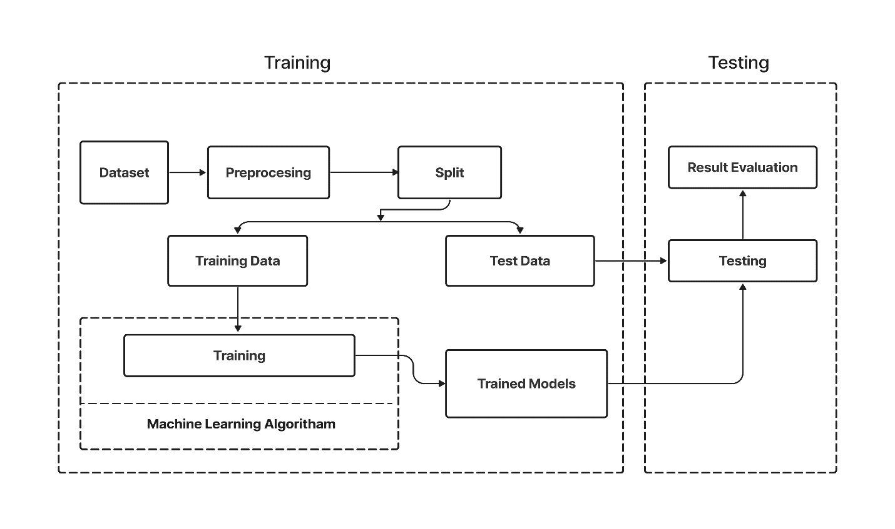
Proposed Method
Fig: System diagram of proposed method
6

Slide 7
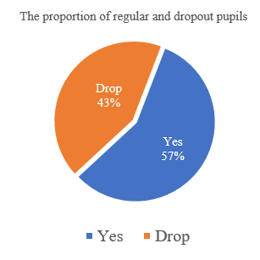
Dataset Collection
We have overall dataset of 654 of students from 8 different rural areas in Bandarban Hill Tracts.
Location | Yes | Drop | Total
Janka para | 21 | 10 | 31
Vangamura para | 8 | 7 | 15
Minijiri para | 7 | 5 | 12
Amtoli para- 2 no. kuhalong | 37 | 45 | 82
Majher para | 12 | 8 | 20
Gunguru mukh para | 38 | 34 | 72
Chemi dolu para | 197 | 142 | 339
Gunguru Maddhyam para | 46 | 37 | 83
Fig: Proportion of regular and
Dropout student
Total 654
7
Table: Student data statics

Slide 8
Datset description
SN | Attribute | Type | Description | Values
1 | Class | Numerical | Class of students: 1-5(Primary level), 6-8 (High school level), 9-10 (secondary level). | Different numerical values
2 | Father monthly income | Numerical | Monthly income of the father in BDT | integer values and range of income 0 BDT to 40000 BDT
3 | Father education | Categorical | The educational class of the father (class 4 to class 12) has been completed. | ‘Class 4’ : 4; ‘Class 5’ : 5; ‘class 6’ : 6; ‘class 7’ : 7, ‘class 8’ : 8, ‘class 9’ : 9; class 10’ : 10, ‘class 11’ : 11, ‘class 12’ : 12.
8

Slide 9
Dataset description Cont.
4 | Mother monthly income | Numerical | Monthly income of the mother in BDT | integer values and range of income 0 BDT to 15000 BDT
5 | Mother education | Categorical | The educational class of the mother (class 3 to class 10) has been completed. | ‘Class 3’ : 3; ‘Class 4’ : 4; ‘Class 5’ : 5; ‘class 6’ : 6; ‘class 7’ : 7, ‘class 8’ : 8, ‘class 9’ : 9; class 10’ : 10.
6 | Number of family members | Numerical | Total number of family members | Different integer values, which range between 3 to 13
7 | Number of educated family member | Numerical | Up to class 10 (range between o to 5) | Different integer values
8 | Neighbor | Categorical | Number of neighbors surrounding the students and family | Different integer values, which range between 1 to 9
9 | Go to school | Nominal | This is the target attribute which classify with “yes” and “drop” | Yes = 1 Drop = 0
9

Slide 10
Model Comparision
SN | Classifiers | Training |  |  |  | Testing
 |  | Precision | Recall | F1-Measure | Accuracy | Precision | Recall | F1-Measure | Accuracy
1 | Random Forest | 1.00 | 1.00 | 1.00 | 1.00 | 0.82 | 0.84 | 0.83 | 0.81
2 | Decision Tree | 1.00 | 1.00 | 1.00 | 1.00 | 0.79 | 0.84 | 0.81 | 0.79
3 | Logistic Regression | 0.77 | 0.80 | 0.78 | 0.74 | 0.71 | 0.73 | 0.72 | 0.68
4 | KNN | 0.83 | 0.80 | 0.82 | 0.79 | 0.74 | 0.66 | 0.70 | 0.68
5 | Naïve Bayes’ | 0.82 | 0.69 | 0.75 | 0.74 | 0.76 | 0.74 | 0.75 | 0.73
6 | SVM | 0.58 | 1.00 | 0.73 | 0.58 | 0.56 | 1.00 | 0.72 | 0.56
Table : Result Comparison
10

Slide 11
Confusion Matrix
SN | Classifiers | Training |  |  |  | Testing
 |  | TN | FP | FN | TP | TN | FP | FN | TP
1 | Random Forest | 221 | 0 | 0 | 301 | 45 | 13 | 12 | 61
2 | Decision Tree | 221 | 0 | 0 | 301 | 42 | 16 | 12 | 61
3 | Logistic Regression | 148 | 73 | 61 | 240 | 36 | 22 | 20 | 53
4 | KNN | 172 | 49 | 60 | 241 | 41 | 17 | 25 | 48
5 | Naïve Bayes’ | 176 | 45 | 92 | 209 | 41 | 17 | 19 | 54
6 | SVM | 0 | 221 | 0 | 301 | 0 | 58 | 0 | 73
11
Table : Value of confusion matrix

Slide 12
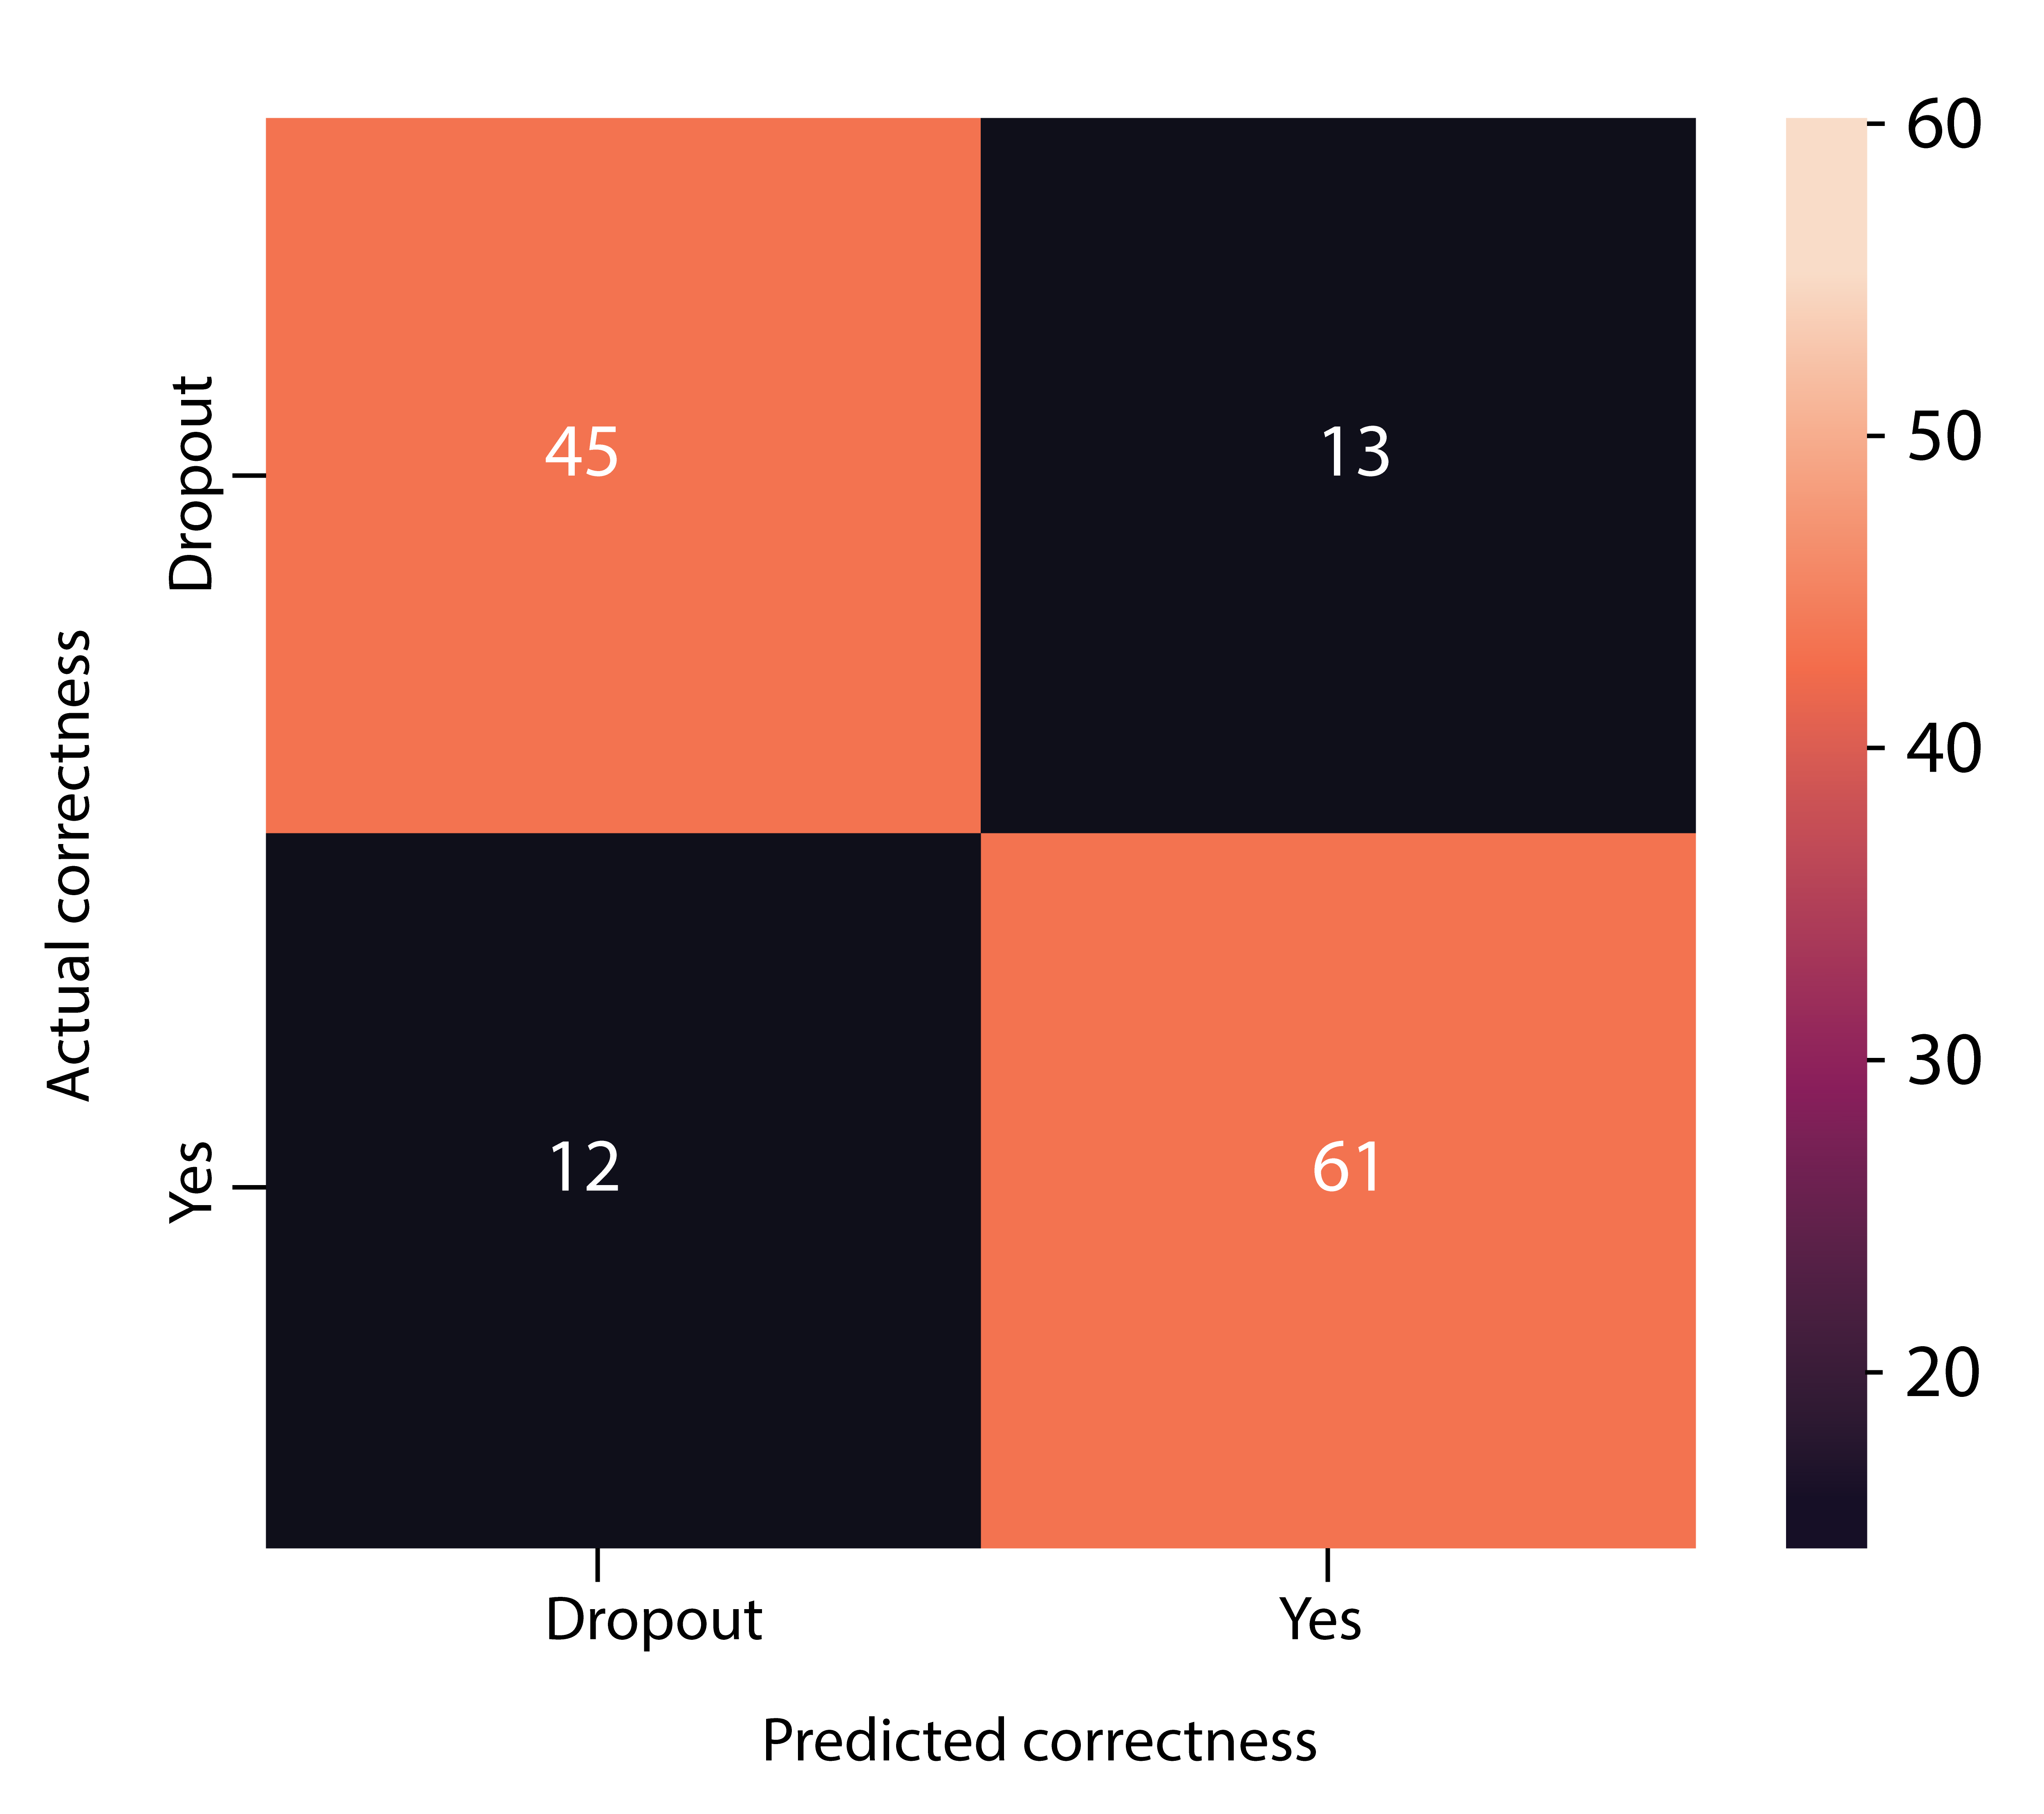
Confusion Matrix
12
Fig: Confusion matrix of Random Forest classifier with testing data

Slide 13
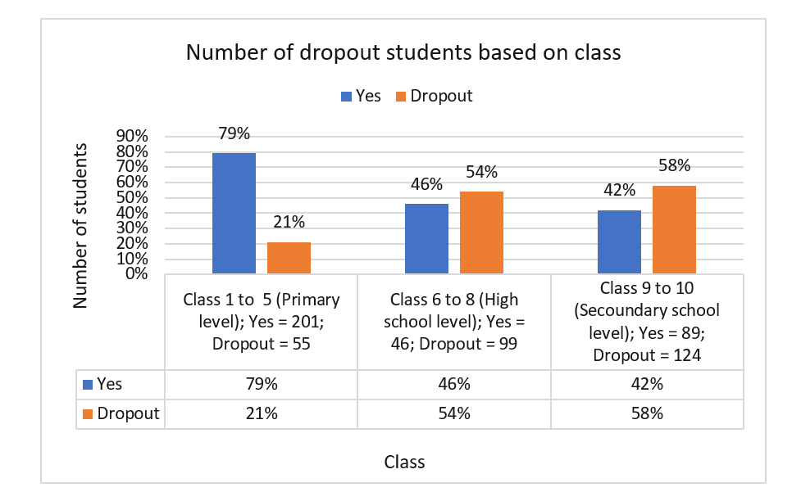
Dataset Exploration
Fig: Class and Dependent attribute statics
13

Slide 14
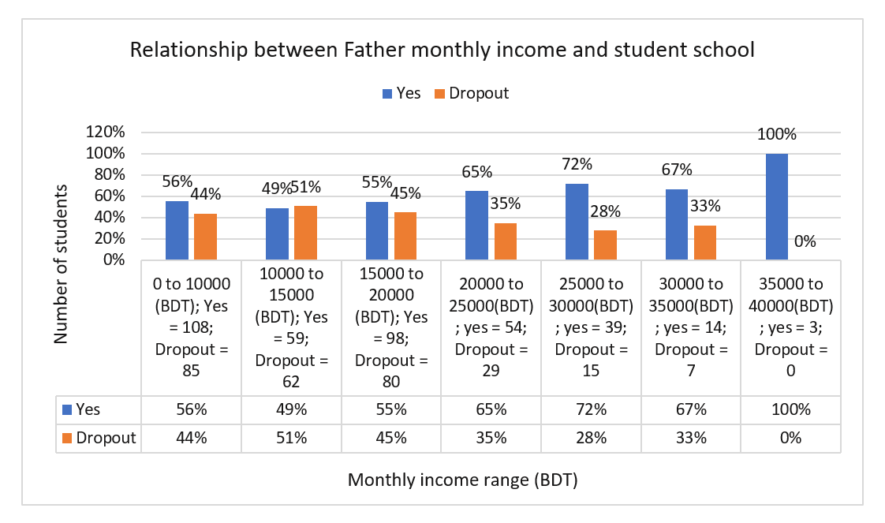
Continue
Fig: Father monthly income and Dependent attribute statics
15

Slide 15
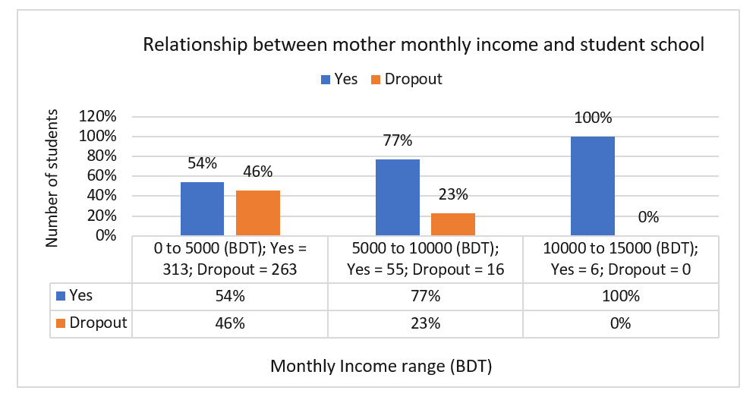
Continue
Fig: Mother monthly income and Dependent attribute statics
16

Slide 16
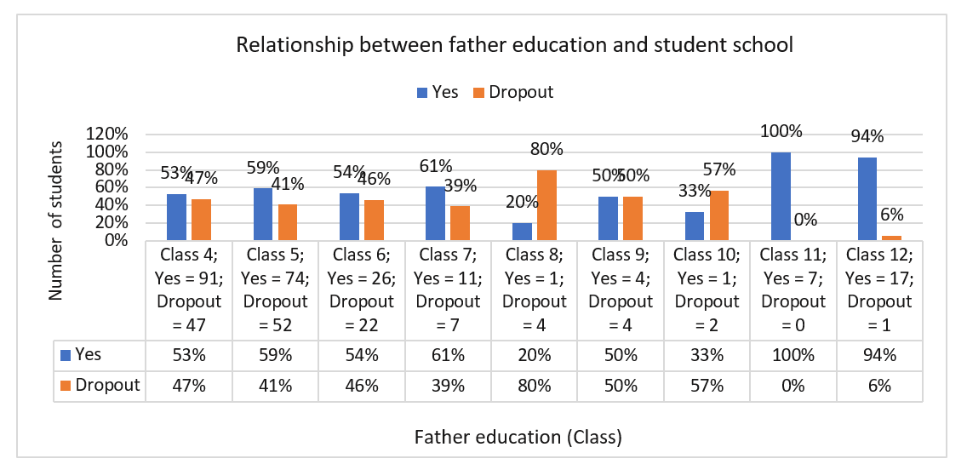
Continue
Fig: Father Education and Dependent attribute statics.
16

Slide 17
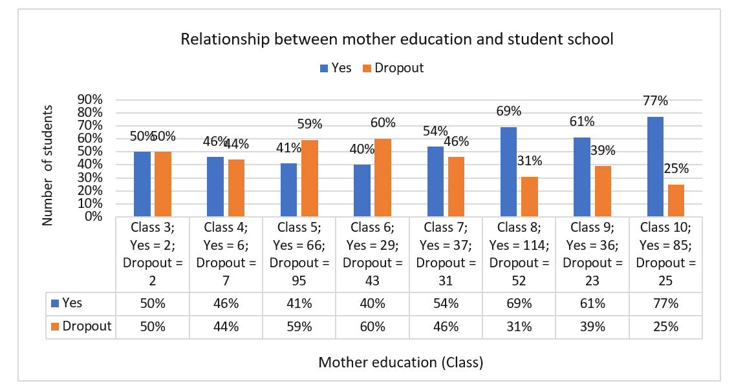
Continue
Fig: Mother Education and Dependent attribute statics.
17

Slide 18
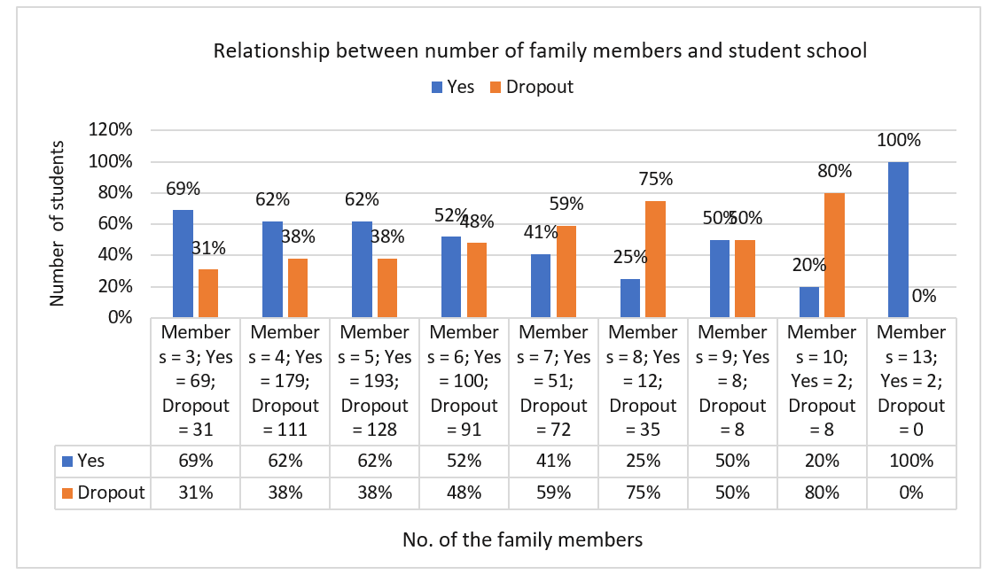
Continue
Fig: Number of family members and Dependent attribute statics.
18

Slide 19
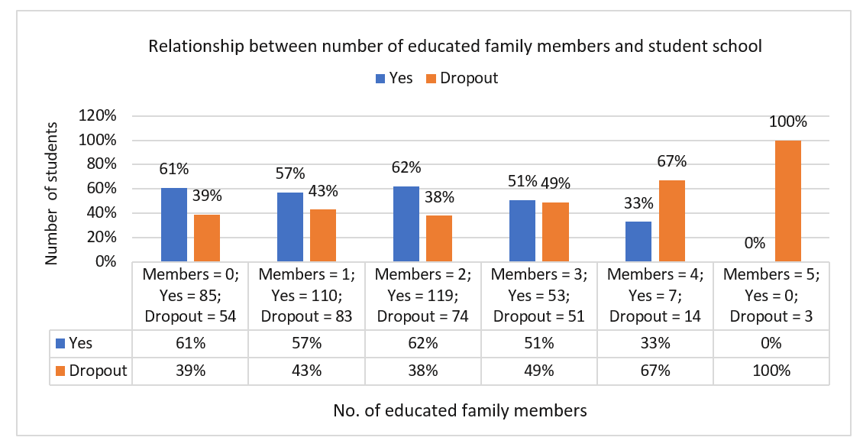
Continue
Fig: Number of educated family members and Dependent attribute statics.
19

Slide 20
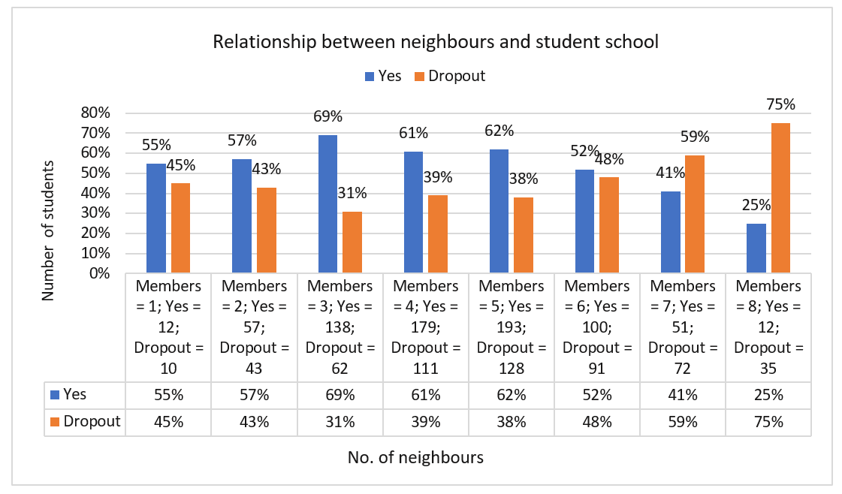
Continue
Fig: Number of neighbors and Dependent attribute statics.
20

Slide 21
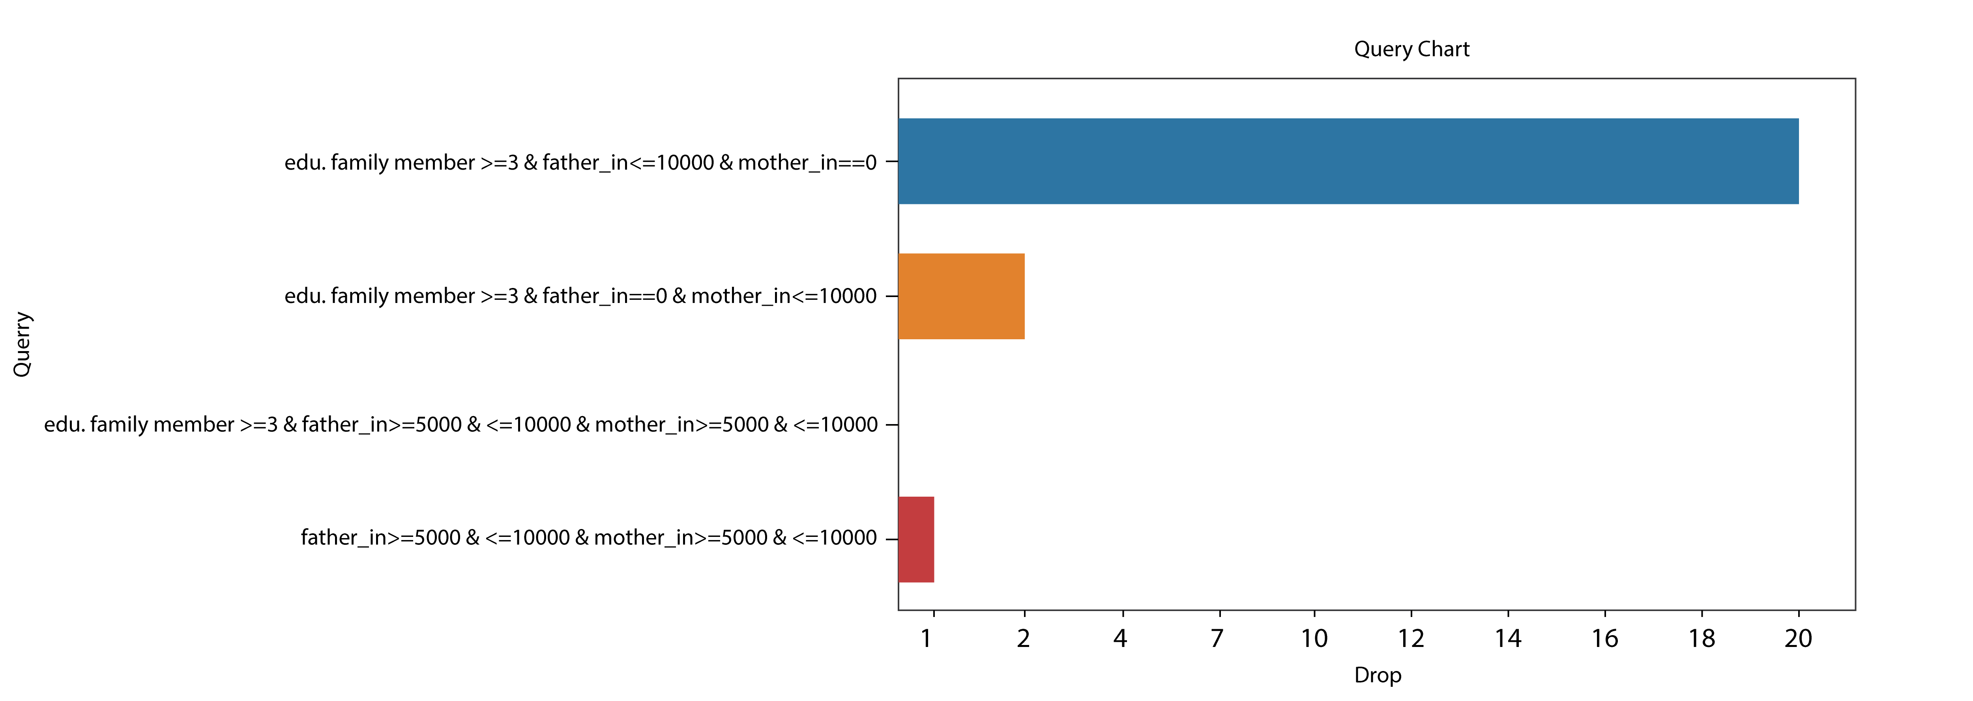
Query
Fig: Query
21

Slide 22
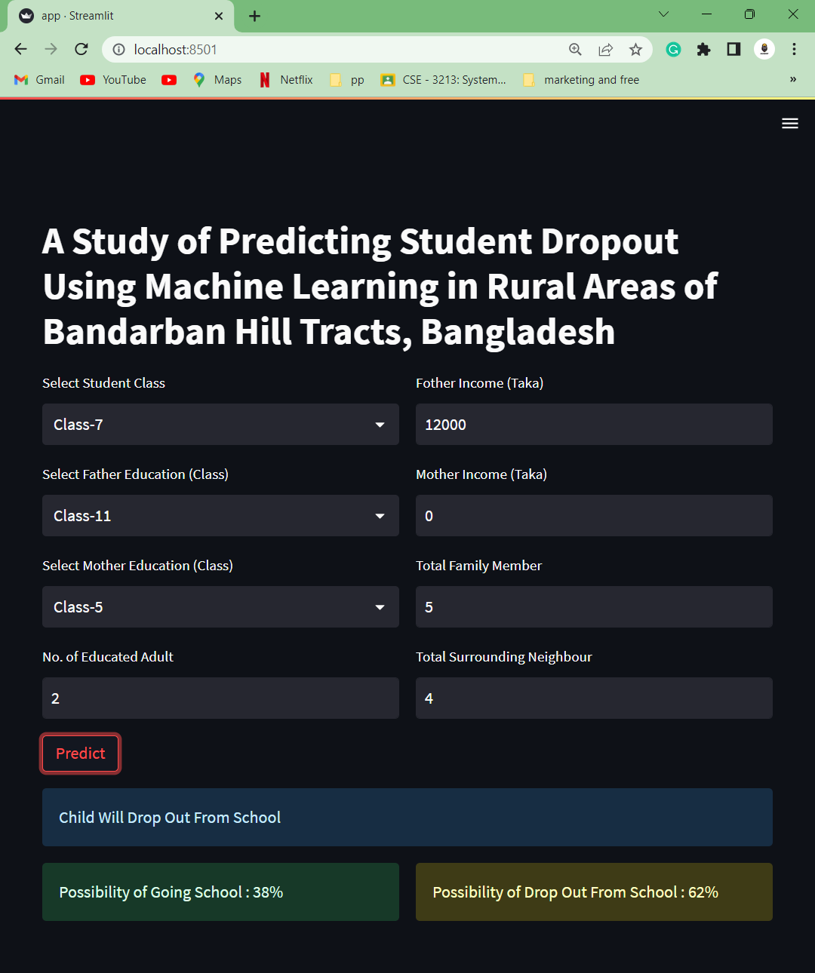
User interface implementation
22
Fig: User Interface

Slide 23
Limitation
Limited availability and quality of data
Limited generalizability of findings
Role of social and cultural factors
Limited capacity of long-term evaluation
23

Slide 24
Future work
Expending the study of scope
Exploring additional variables
Developing targeted interventions
Incorporating Machine learning techniques
24

Slide 25
Thank You

